Slide 1
Planning and Budgeting
September 15, 2022
Wenchen Wang
Notes:
Planning and Budgeting are important for an organization, especially the public service organizations that not all activities are directly related to profit maximization. What is the organization trying to achieve? Why does it want to achieve that goal? How does it intend to translate that goal into results?

Slide 2
Last Week
Term Definitions:
Financial Management
Accounting
Finance
Financial Management in the Public Service Organizations
Public Service Organizations Resource Flows
Governments
Health-care Services Industry
Non-profits
Notes:
Financial Management: The part of the management process that focuses on financial information that can be used to improve decision making.
Important: earnings to achieve goals, increase effectiveness and efficiency
Profits are important: safety margin; replacement (equipment and facilities) and expand services
We use accounting to keep track of the financial status of the organization; we use finance to manage the alternative sources and uses of the sources within an organization
Managerial accounting: financial information for planning and decision making
Financial accounting: tracking and reporting the resources owned and used by the organization

Slide 3
Learning Objective
Missions and Strategic Plan for Public Service Organizations
Budget
Definition
Types
Process
Notes:
Planning is accomplished by establishing the mission and defining strategic plans for the organization. preparing specific,
When planning, we need to prepare detailed budget, which describes where resources will come from and how they will be used.

Slide 4
Mission for Public Service Organizations
What
Who
Where
How
Why
Notes:
So the overall missions for the public service organizations should be providing public-related service. But what are the specific components of their missions?
A good mission statement answers five questions. The first three define the domain of the organization.
“What does the organization plan to do?,”
“Who will it serve?,”
“Where will it operate?”
“How does the organization plan to deliver its services?
“Why choose its specific social purpose?”

Slide 5
Mission Statement Exercise
Write a one-sentence mission statement describing the five elements we talked about for a foundation which conducts research on rare cancer in the U.S.
Notes:
Conciseness, include both breadth and limitations

Slide 6
Mission Statement Exercise
Write a one-sentence mission statement describing the five elements we talked about for a foundation which conducts research on rare cancer in the U.S.
The Rare Cancer Research Foundation is dedicated to curing rare cancers through strategic investments and innovative collaborations that facilitate effective research and accelerate the deployment of promising therapies to help light up the hopes for the tens of thousands of patients and their families in the U.S.
Notes:
The Rare Cancer Research Foundation is dedicated to curing rare cancers through strategic investments and innovative collaborations that facilitate effective research and accelerate the deployment of promising therapies to help light up the hopes for the tens of thousands of patients and their families in the U.S.
Conciseness, include both breadth and limitations

Slide 7
Organizational Strategic Plan
Goals and Broad Strategies:
Direct goals
Indirect goals
Expansion goas
Long-range Plan (Operating Plan):
Nonfinancial aspects
Financial aspects
Notes:
The strategic plan defines the primary approaches that the organization will take to achieve its mission. Generally, strategic plans do not have specific financial targets. However, they set the stage for specific, detailed budgets:
Direct goals for Meals: Directly provide nutritious meals to the homeless and indigent in the area---How: use food trucks, soup kitchen
Indirect goals: campaign to encourage the public to provide meals for the homeless and indigent in the area; lobbying the legislation for related food program
Expansion goals: expand targeted population; expand funding resources to increase services--- corporate sponsorships and direct fundraising.
Long-range plans establish the major activities that will have to be carried out in the coming 3 to 5 years. This process provides a link between the strategic plan and the day-to-day activities of the organization.
Nonfinancial aspects: quality in providing a service; non-quantifiable outcomes that the organization is trying to achieve. Eg: whether the meals meet its nutritional targets
Financial aspects: Eg: add new locations for expansion; how to raise money for the expansion. Spread out by year to achieve the final expansion goal):
Year 1: Establish a fundraising campaign and begin fundraising. Raise enough money to open one new site.
Year 2: Add a food distribution/soup kitchen location. Raise additional money to acquire and operate a vehicle and open another location. Solicit more restaurants for leftover food donations.
Year 3: Add another food distribution/soup kitchen location and a new vehicle. Raise additional money to acquire and operate a vehicle and open another location. Solicit more restaurants for leftover food donations.
Year 4: Add another food distribution/soup kitchen location and a new vehicle. Raise additional money to acquire and operate two vehicles. Solicit more restaurants for leftover food donations.
Year 5: Add two new vehicles. Raise additional money to begin replacement of old kitchen equipment and old vehicles. Get enough contributions to at least reach a steady state in which replacements take place as needed.

Slide 8
Budgets
What can be done vs. what can’t be done to accomplish the organization’s objectives.
Gap in providing services and receiving payments
Surplus
Deficit
Predictions and decisions
Balancing Budgets results in limiting services provided
Notes:
Budget is simply a detailed action plan. The plan indicates management’s objectives and shows how it expects to obtain, pay for, and use resources to achieve those objectives. The budget indicates the amount of money that an organization expects to earn and receive from all sources for the period it covers, which is usually a year. It also indicates the amount of resources the organization expects to use in its operations, and the amount of money that it will pay for those resources.
How many homeless will there be next year? What percentage of the homeless will be children? How many workers should the organization assign to fundraising?

Slide 9
Budgets
Master Budget
Operating budget
Cash budget
Capital budget
Special Types of Budgets
Financial Budget
Notes:
The master budget incorporates and summarizes all the budget elements for the coming year. These elements provide the specific detail to accomplish both the routine ongoing activities of the organization and the coming year’s portion of the long-range plan.

Slide 10
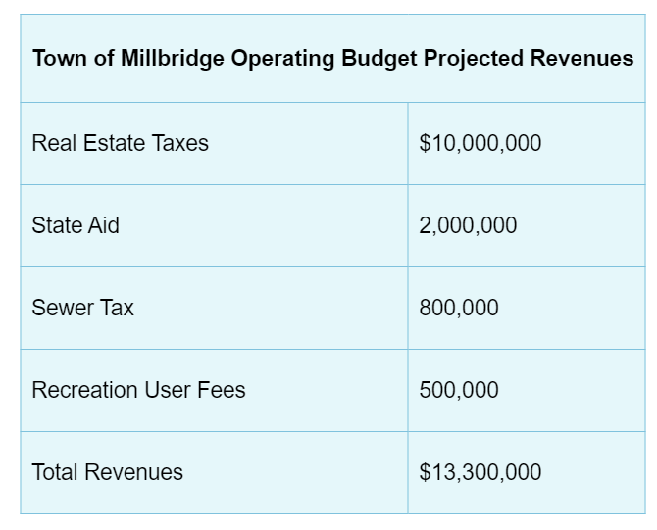
Operating Budgets
Revenues: by different major sources
Notes:
The operating budget presents a plan for revenues and expenses for the fiscal year. Revenues are the resources the organization earns in exchange for providing goods or services.
Major sources: taxes and fees can be grouped together.

Slide 11
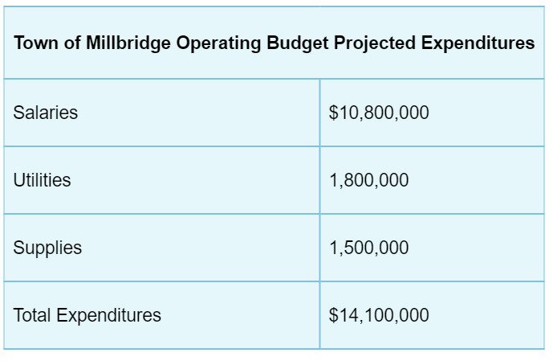
Operating Budgets
Expenditures
Notes:
The operating budget presents a plan for revenues and expenses for the fiscal year. Expenses are the resources used or consumed in the process of providing goods and services.
The order for doing revenue budget and expenditure budget does not matter.
Deficit or Surplus? ($800,000)
In general, the town council would not legally be allowed to adopt a budget containing a deficit. Ives would have to go back to each element of the operating budget, finding additional revenues and/or reducing expenditures.

Slide 12
Cash vs Accrual Accounting
Revenues and Expenses are recognized it means that there is acknowledgment that some financial event has occurred
Cash Accounting recognizes
Revenues when payments are received in cash
Expenses when resources are paid in cash
Accrual Accounting recognizes
Revenues when good or services have been delivered and the organization has earned the right to be paid
Expenses when resources have been used in the operation

Slide 13
Cash vs Accrual Example
Assume that an organization charges $5,000 for its services, but only collects $3,000 this year. The remainder will be collected next year.
The organization’s only cost is salary of its manager who earned $4,500 but was only paid $3,750. The balance will be paid next year.
 | CASH | ACCRUAL
Revenue | $3,000 | $5,000
Expense | $3,750 | $4,500
Surplus/(Deficit) | $(750) | $500

Slide 14
Cash vs Accrual
CASH
It is simple
Gives an idea of how much cash the organization has
Result in misleading depiction of financial operations
ACCRUAL
Helps an organization match the revenues that it has earned with the resources required to produce those revenues
More appropriate in measuring the profitability of an organization and is more difficult to manipulate
It is more accurate but more difficult
Notes:
Cash accounting does not do a good job of letting managers understand whether the organization’s activities are profitable.
Accrual accounting is the actual matching of services provided and the money received.

Slide 15
Cash vs Accrual Example
A nonprofit organization provides soccer programs to kids (ages 13-17) in the afternoons. The organization receives 100 kids per month. Each kid pays $200 every month. Usually, parents pay 30% the first day of the month and 70% two months after that.
Every month the organization pays $4,000 in salaries, $6,500 in rent, and $6,000 for the supplies of the restaurant. Salaries and rent are paid in the same month. The organization pays 50% of the supplies in the same month and 50% in the next month.
What is the surplus/deficit in the first month of operations?

Slide 16
Cash vs Accrual Exercise
A nonprofit organization provides soccer programs to kids (ages 13-17) in the afternoons. The organization receives 100 kids per month. Each kid pays $200 every month. Usually, parents pay 30% the first day of the month and 70% two months after that.
Every month the organization pays $4,000 in salaries, $6,500 in rent, and $6,000 for the supplies of the restaurant. Salaries and rent are paid in the same month. The organization pays 50% of the supplies in the same month and 50% in the next month.
 | Cash | Accrual
Revenues
Expenses
Surplus/(Deficit)
Which method would give a better picture of the organization’s results from these activities?
Notes:
Cash : $6000-$13,500=($7500)
Accrual: $20,000-$16,500=$3500

Slide 17
Cash vs Accrual Exercise
A nonprofit organization provides soccer programs to kids (ages 13-17) in the afternoons. The organization receives 100 kids per month. Each kid pays $200 every month. Usually, parents pay 30% the first day of the month and 70% two months after that.
Every month the organization pays $4,000 in salaries, $6,500 in rent, and $6,000 for the supplies of the restaurant. Salaries and rent are paid in the same month. The organization pays 50% of the supplies in the same month and 50% in the next month.
 | Cash | Accrual
Revenues | ($200*100)*30% | $200*100
Expenses | $4,000+$6,500+(6,000*50%) | $4,000+$6,500+$6,000
Surplus/(Deficit) | ($7,500) | $3,500
Which method would give a better picture of the organization’s results from these activities?

Slide 18
Financial Budget
Cash budget
Cash Receipts and Disbursements
Capital budget
Acquisition of long-term resources
Notes:
The cash budget focuses primarily on the coming year. The cash budget plans for the cash receipts and disbursements of the organization. It asks the question: Do we expect to receive enough money (from clients, residents, donors, etc.) during the budget period to make the payments (for salaries, supplies, rent, etc.) that we expect to make during that time?
The capital budget plans for cash receipts and payments specifically for resources that will provide service for a period longer than just the coming year, such as buildings and equipment. Capital budgeting is discussed in Chapter 5.

Slide 19
Cash Budget
Plan for an organization’s cash inflows and outflows
It is the same to the operating budget if the organization uses ________ basis of accounting
Beginning Cash Balance
+ Cash receipts
= Available cash
- Cash payments
= Subtotal
+/- Cash from borrowing (lending)
= Ending cash balance
Notes:
The cash budget is identical to the operating budget for organizations that use the cash basis of accounting. For organizations using the accrual basis of accounting, the cash budget provides vital additional information. It helps managers know when there will be cash available for investment and when a shortage of cash is expected. This information allows the organization either to arrange for sources of cash (such as a loan from the bank) to alleviate an expected shortfall or to change the organization’s planned revenues and expenses to avoid the shortage.
Textbook also has: +/- Cash from Sale (Purchase) of Investments

Slide 20
Cash Budget Example
Minnetonka’s urban planner for social services is working on the budget for the town’s day care center. The center allows lower income citizens to hold jobs. The Center is paid each month by the county and state to care for children.
State: Pays 50% of the billed amount one month after receiving the bill, and the other 50% two months after receiving a bill.
County: Pays 100% of the billed amount two months after receiving the bill.
Parents are also required to pay the Center for caring for their children. Parents pay the full amount that they owe on the first day of the month that it is due. Based on the operating budget on the next slide, how much cash can the Center expect to collect in the four months?

Slide 21
Revenues by Month
Revenue | M1 | M2 | M3 | M4
State | $20,000 | $15,000 | $10,000 | $5,000
County | $25,000 | $30,000 | $35,000 | $40,000
Parents | $5,100 | $4,800 | $5,200 | $5,000
Total | $50,100 | $49,800 | $50,200 | $50,000

Slide 22
Revenues by Month
Revenue | M1 | M2 | M3 | M4
State | $20,000 | $15,000 | $10,000 | $5,000
County | $25,000 | $30,000 | $35,000 | $40,000
Parents | $5,100 | $4,800 | $5,200 | $5,000
Total | $50,100 | $49,800 | $50,200 | $50,000
Cash Budget |  | M1 | M2 | M3 | M4
Beginning Cash Balance
State | 50% after 1 month 50% after 2 months
County | 100% after 2 months
Parents | 1st day of the month
Total
Notes:
Note the difference between the cash and revenue for the month!!!

Slide 23
Revenues by Month
Revenue | M1 | M2 | M3 | M4
State | $20,000 | $15,000 | $10,000 | $5,000
County | $25,000 | $30,000 | $35,000 | $40,000
Parents | $5,100 | $4,800 | $5,200 | $5,000
Total | $50,100 | $49,800 | $50,200 | $50,000
Cash Budget |  | M1 | M2 | M3 | M4
Beginning Cash Balance |  | $0 | $5,100 | $19,900 | $67,600
State | 50% after 1 month 50% after 2 months |  | $10,000 | $10,000+$7,500 | $7,500 + $5,000
County | 100% after 2 months |  |  | $25,000 | $30,000
Parents | 1st day of the month | $5,100 | $4,800 | $5,200 | $5,000
Total |  | $5,100 | $19,900 | $67,600 | $115,100
Notes:
Note the difference between the cash and revenue for the month!!!

Slide 24
Capital Budget
To plan for the acquisition of high-value, long-term (> 1 year) assets.
Accrual Accounting and Capital Assets
Accrual expenses reflect the use of a resource.
Since capital assets last for many years, it would be inappropriate to show their entire cost as part of the operating budget at the time they are acquired.
We show one year's share of the cost in the operating budget each year it is used, and show the full cost on the capital budget the year the capital asset is acquired
Notes:
One reason the capital budget is used relates to the issue of accrual accounting. If Meals buys a delivery truck with a 5-year life, it would be inappropriate to charge the entire cost of the truck to the coming year. Suppose that a delivery truck costs $40,000. Even if Meals will pay $40,000 cash for the truck next year, and therefore it will be a $40,000 reduction in the cash budget, Meals will not fully use up the truck in the 1 year. Part of the truck will be used in future periods. It would not be reasonable to charge the entire $40,000 cost of the truck as an expense in its first year. Organizations that use accrual accounting would spread the $40,000 cost of the truck out over the years it is used, charging a portion as an expense each year. Thus, the full cost of the truck will be included in the capital budget, but only a 1-year portion of the cost of the truck will be included as an expense, called depreciation expense, in the operating budget each year.

Slide 25
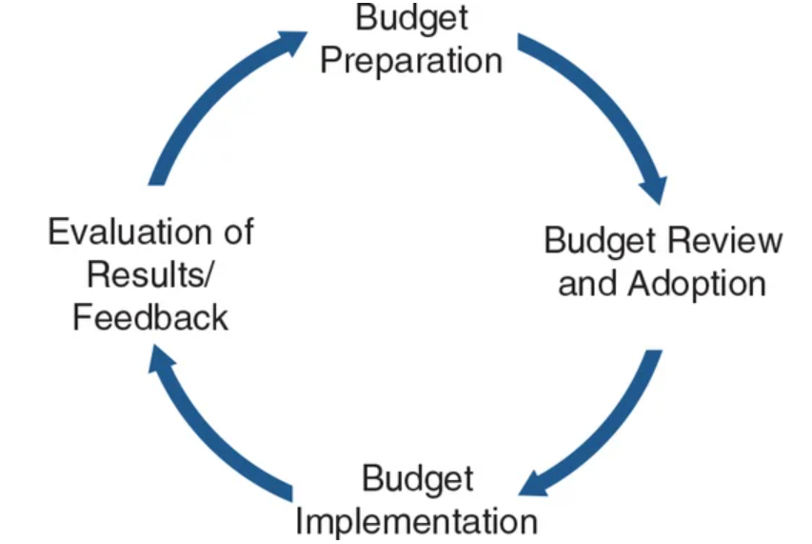
Budget Process
Budgeting is a process of planning and control.
Budget Cycle:
Notes:
Budgeting can contribute significantly to greater efficiency, effectiveness, and accountability in the overall management of an organization’s financial resources.
Budget preparation: assumptions and guidelines, quantify their budgets, unique forms for each organization (Chapter 3)
Budget review submit both the budget and an executive summary to the decision-making body for review and approval. The summary should focus on the policy implications of the proposed budget.
For example, in the governmental organization, the executive branch submits the budget to the legislative branch for review. In many cases, the legislative process includes an opportunity for public scrutiny and comment. In some cases, the public actually votes on the budget, but this is less common and occurs primarily with respect to school budgets. If the executive is unhappy with changes made by the legislature, the budget can be vetoed. In many cases the veto can be for the entire budget; in some cases, the veto may be line item by line item. Generally, there is some provision for the legislature to override a veto.
Budget implementation: focuses on expenditure control, managing the organization within the limits of the adopted budget
Evaluation: comparing actual results to the budget (performance evaluation). Interim and ad-hoc

